Slide 1

System Analysis and Design Laboratory
(CSE 3412)
Assessment Hacks!
Mohaimenul Azam Khan Raiaan : 011 191 228
Sumaiya Akter : 011 191 180
Fazila Nabi Chowdhury Kashpiya : 011 182 097
Nur Mohammad Fahad : 011 191 040

Slide 2
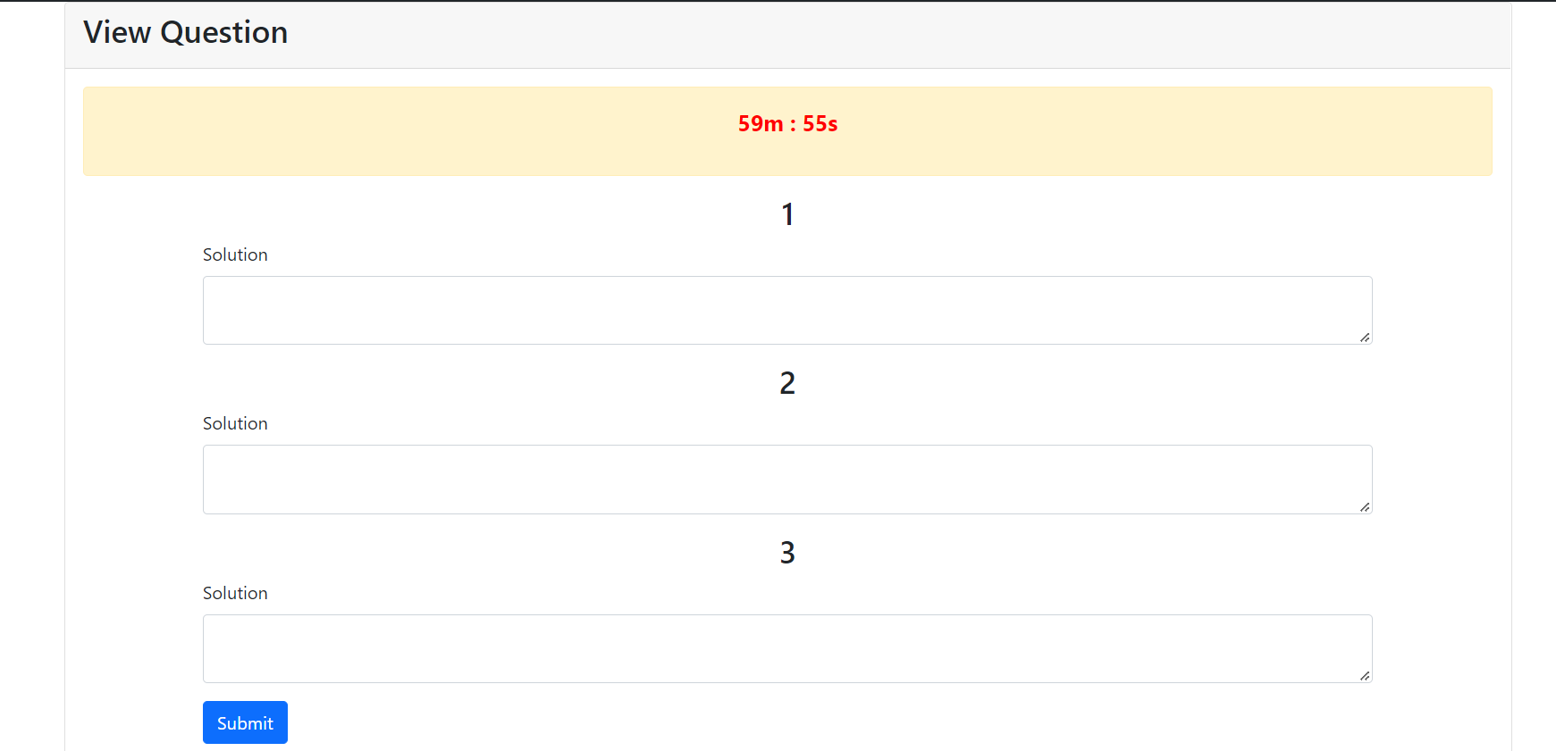
Visibility
Time Counter
This is the page for attempting an exam by an examinee. This page shows that an examinee can see the exam's time status.
And an examinee can see how many questions needs to answer, and after completing the exam,
the examinee has a submit button. Every step is shown here, one after another, and the system's status is also visible clearly.

Slide 3
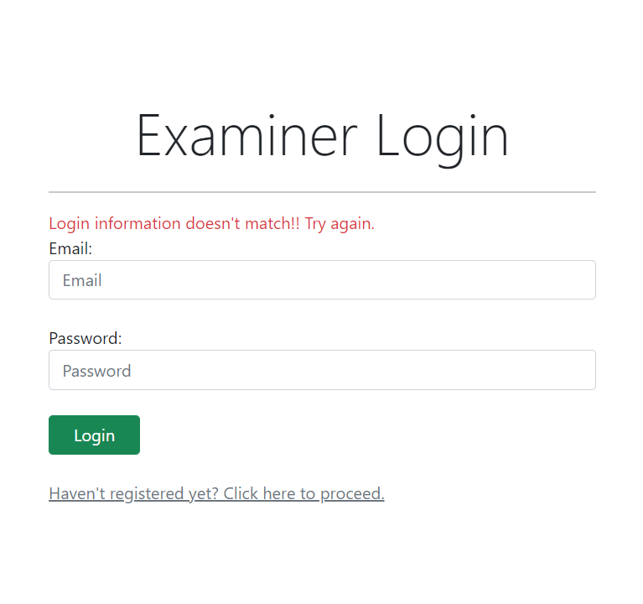
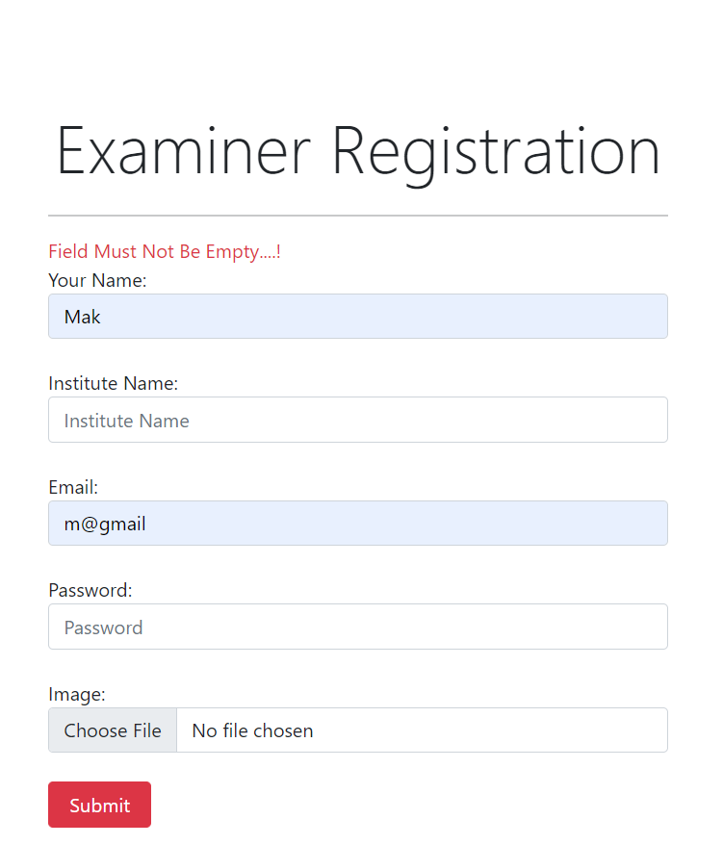
Error Recovery
This is the page for login and registration. After making an error, it's visible that the system guides the user on what's the error and what to do to recover it.

Slide 4
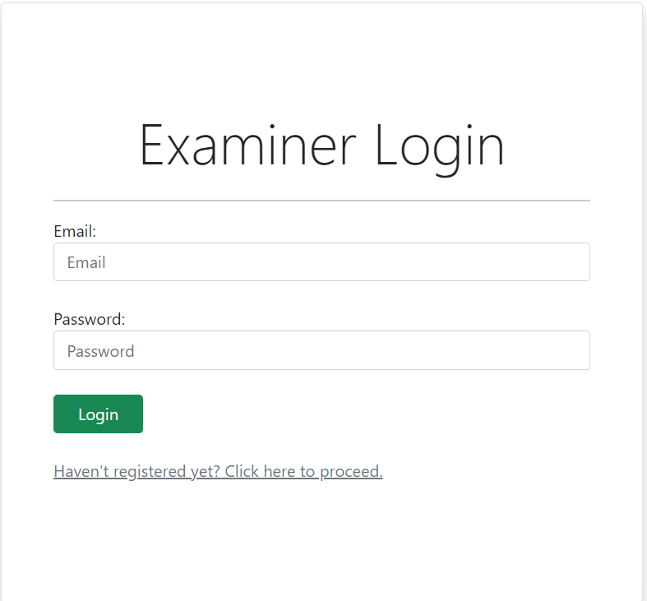
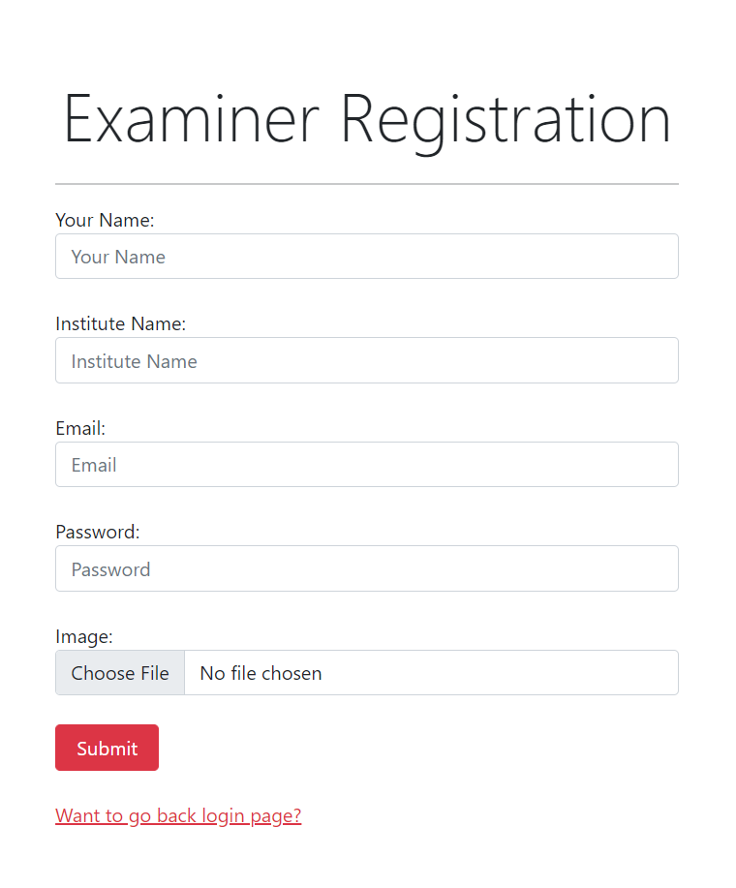
Mapping
Our System’s Login and Registration page is the general login and registration page most websites use. So that users don’t get confused with the interface of the pages.

Slide 5
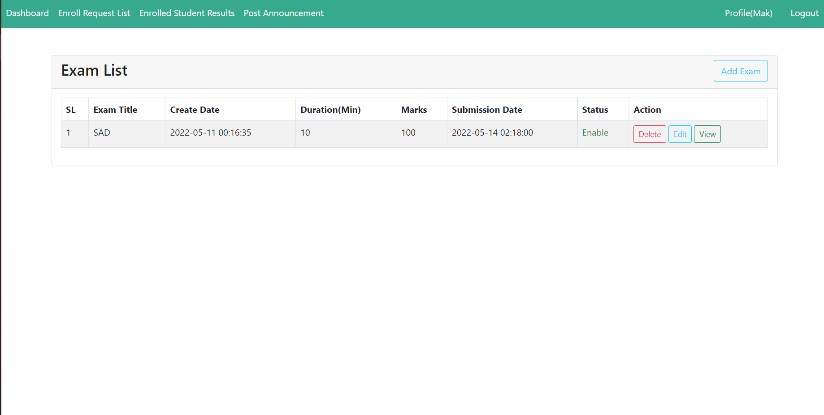
Consistency

Slide 6
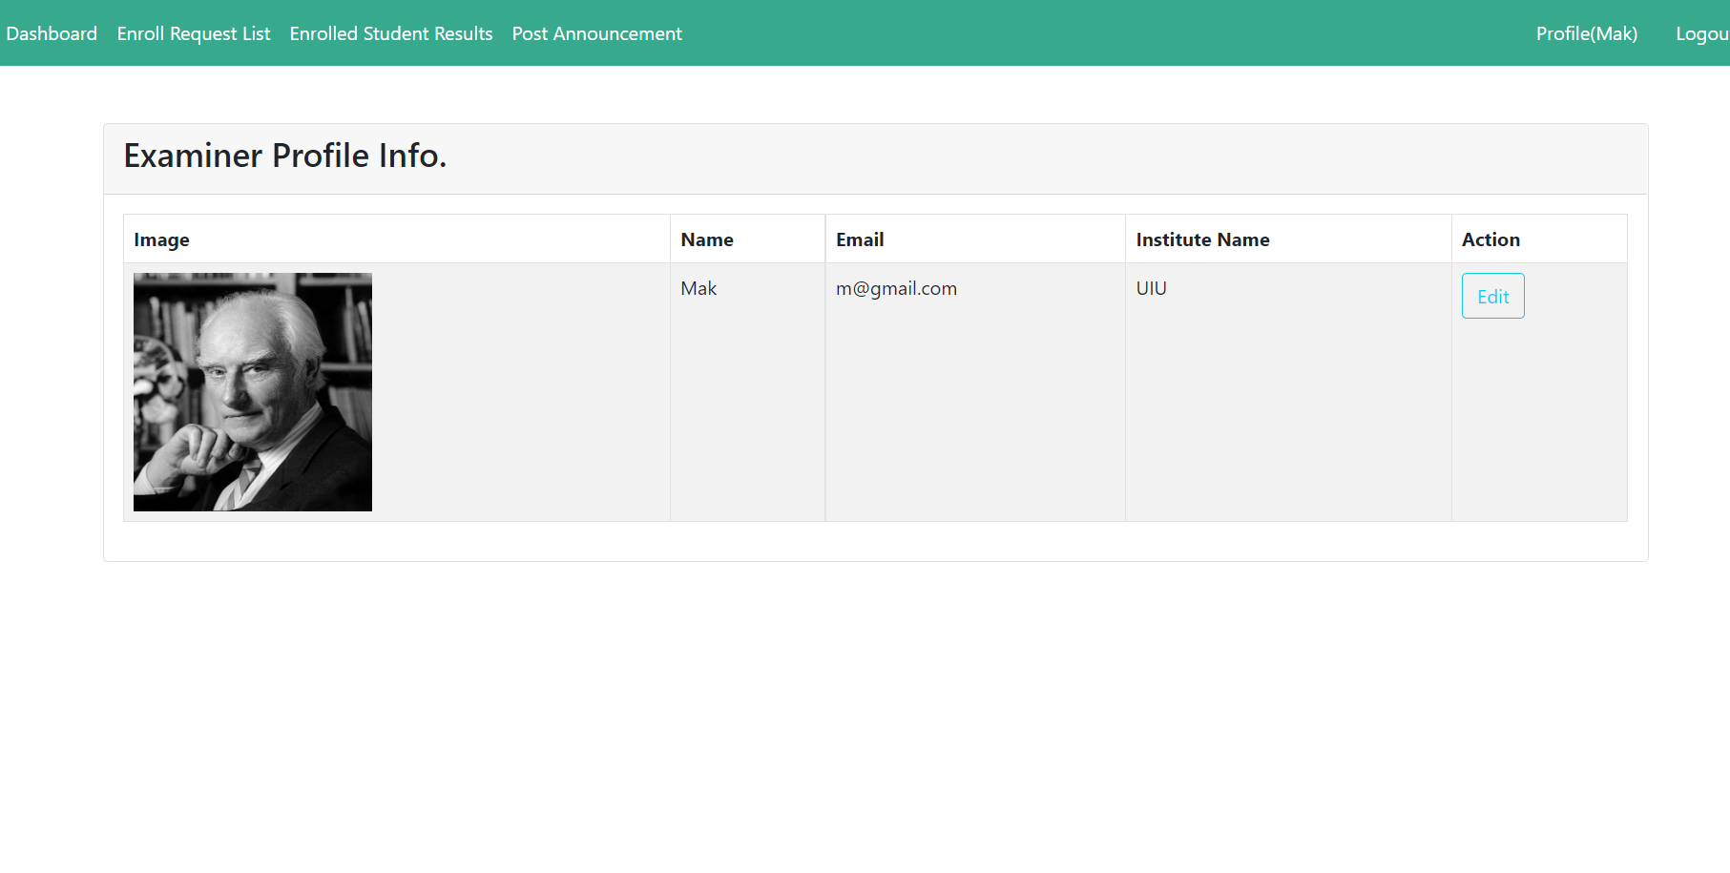
It's essential to maintain consistency. If we look at the navbar of the dashboard and profile edit pages, we can see that both have the same navbar. Every other page has the same navbar as well. We are ensuring consistency in the whole system.

Slide 7
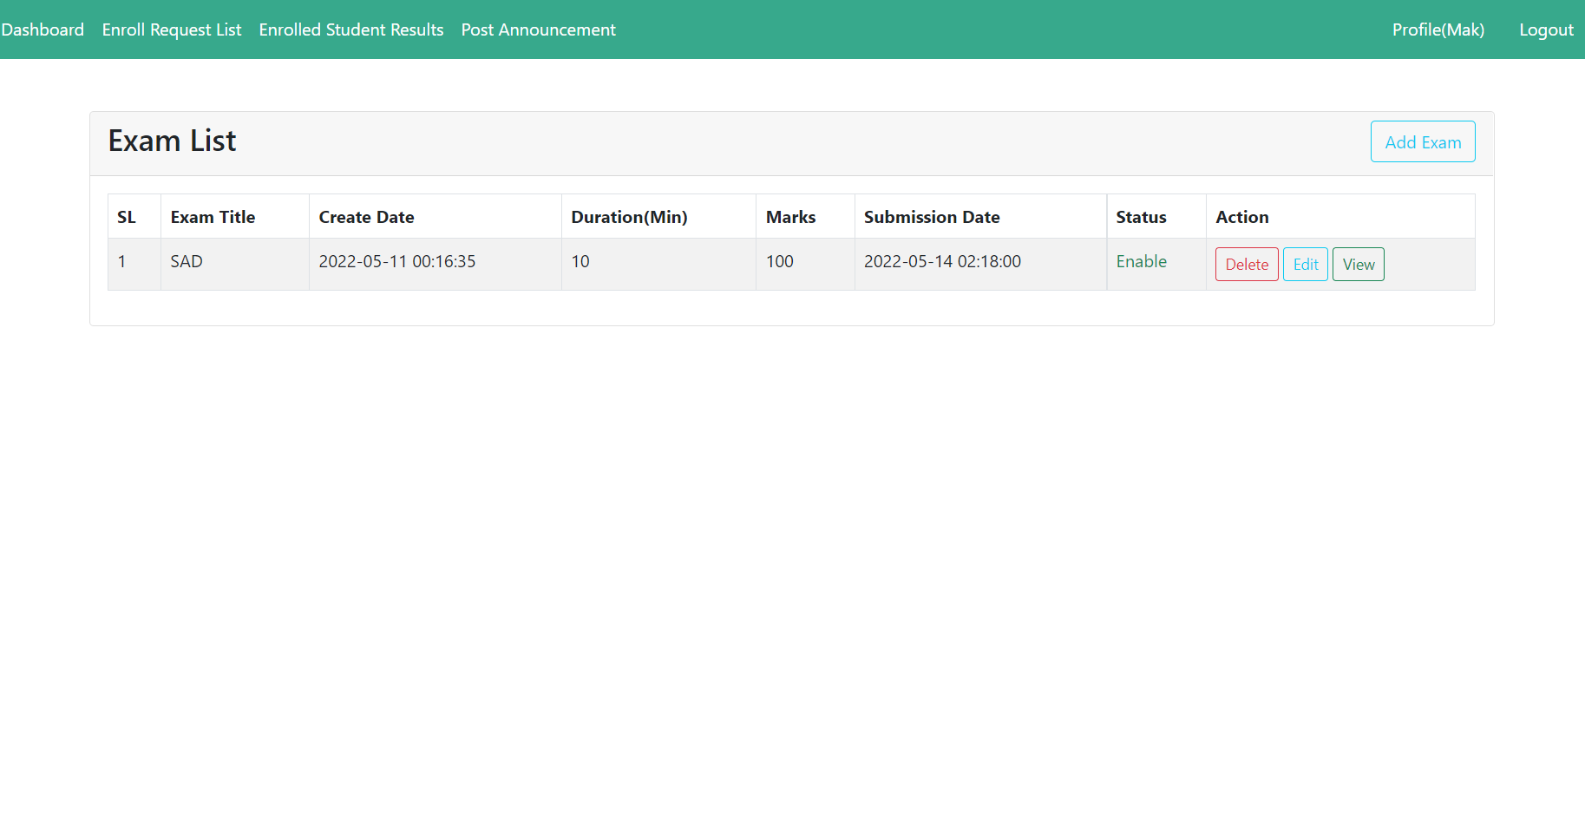
Recognition
If we look at the homepage of the examiner in our system, we can see that every piece of information is easy to discover. An examiner can easily see the add exam, view, edit, and delete options. Navbar shows all other options as well.

Slide 8
Minimalism

Slide 9
Minimalism
In our system, we tried to provide information elegantly. We can see that there are not any unnecessary wordings anywhere. The login, Registration page has a very straightforward direction and wordings, and the homepage also has a particular naming.

Slide 10
Thank You

